Slide 1

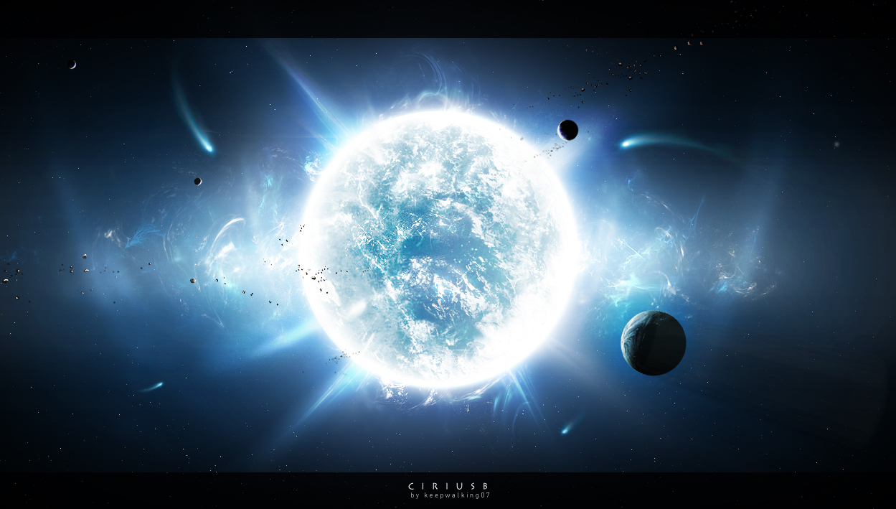
Discovering
Stellar
Secrets

Slide 2
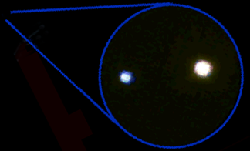
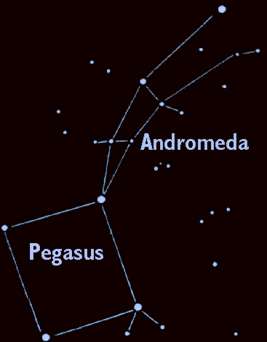
Gamma Andromedae
Through the Telescope
355 light years away in the constellation Andromeda – the “Chained Maiden”

Slide 3


A Pair of Stars
Gamma Andromeda (or Almach) when seen through the telescope is actually two stars.
Gamma 1
Gamma 2

Slide 4
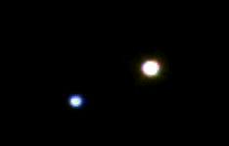

Star Pairs
Pairs of stars are one of two different types:
Optical Double Stars
Binary Stars

Slide 5
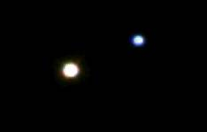

Optical Double Stars
Optical Double stars are just two stars that happen to lie in the same direction in the sky.
(A side view)
If you could see these stars from a different vantage point than Earth, you would see they actually have nothing to do with each other.

Slide 6
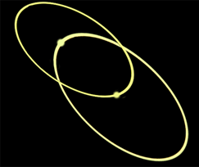

Binary or Multiple Stars
In a Binary (or Multiple) star system the stars are relatively close and orbit each other.

Slide 7

Multiple or Optical Double?
It's all in the distance.
Optical double stars are very large distances apart but appear to be close together because they are in the same line-of-sight.
Multiple stars lie close to each other in space and at about the same distance from Earth.

Slide 8
How Can You Find the Distance to a Star?
Earth
Nearby star
ρ
Background stars
Sun
d
ρ
Apparent positions of the nearby star for observations taken 6 months apart.
The position of a nearby star from different sides of our orbit around the Sun make it seem to shift in the sky. This shift, called parallax, can be used to find the distance to nearby stars.

Slide 9
How do we Find Stellar Masses
Astronomers determine stellar masses by observing binary star systems.
Gamma 1
Gamma 2

Slide 10
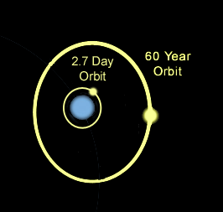
How do we Find Stellar Masses
First we find the time it takes for the two stars to orbit of each other.
Gamma 2
Gamma 1

Slide 11
How do we Find Stellar Masses
Then we find the distance between the two stars.
Gamma 1
Gamma 2
60 billion miles
These two pieces of information tells us the sum of the masses of the two stars.

Slide 12
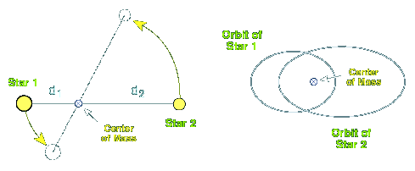
How do we Find Stellar Masses
The two stars are actually orbiting a common point in space called the center of mass. The position of the center of mass relative to the two stars determines the ratio of the masses of the stars.

Slide 13
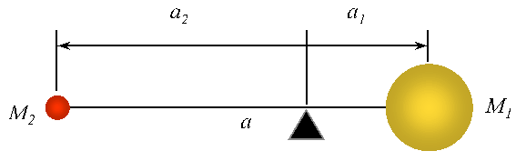
How do we Find Stellar Masses
We know (M₁+M₂), and “a” and we observe the location of the center of mass around which the two stars orbit giving us a₁ and a₂ which gives us the ratio of the stars’ masses to each other which gives their masses.
center of mass

Slide 14
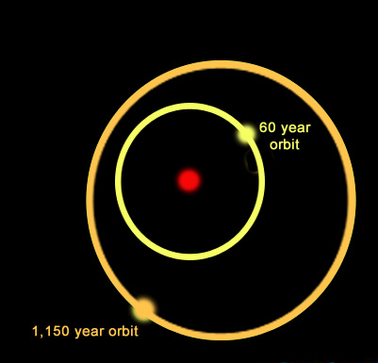
Multiple Star Systems
Star systems come in many varieties. For example, the system shown here is a triple star system:
A yellow star orbits a primary star with a period of nearly 60 years while a more distant companion orbits the inner pair with a period of 1,150 years.
One multiple star system we know of has 9 stars!

Slide 15
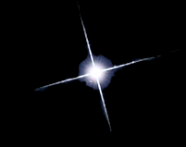

Types of Middle-Aged Stars
Blue stars are
high-mass hot stars.
Yellow stars, similar to our Sun, are average in mass and temperature.
Red stars are
low mass and cool.

Slide 16
Contrast Multiple Stars
Can you identify:
Which star is brightest?
Which star is hottest?
Which star is largest?

Slide 17
Contrast Multiple Stars
The blue star is the hotter of the two, yet the yellow star is the brightest.

Slide 18
Contrast Multiple Stars
How can a star be brighter if it is putting out less heat?

Slide 19
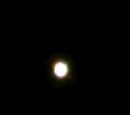
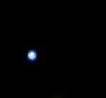
How can that be?
There are two possibilities:
If it is an Optical Double, the cooler star may be nearer to Earth.
If it is a Multiple star, the cooler star may be larger.

Slide 20
Contrast Multiple Stars
Gamma Andromeda is a multiple star, so the two stars are effectively the same distance from us.
Therefore, if the yellow star (Gamma 1) is brighter, then it must be larger.
Gamma 1 is starting to die, so it is turning into a giant.

